Slide 1
ENTERPRISE RESOURCE PLANNING (ERP)

Slide 2
CONTENTS
Introduction
Role of SQL
Tables
Store procedure
Conclusion

Slide 3

INTRODUCTION
ERP
Enterprise Resource Planning (ERP)
is an integrated software that manages core
Business process in real time.
It streamlines process by centralising data across departments like finance, HR, supply chain and manufacturing

Slide 4
Role of sql
SQL is crucial for managing and querying the large databases that ERP system rely on.
Enables seamless integration of data across different modules within an ERP system, ensuring consistency and accuracy.
SQL allows user to generate custom reports and perform data analytics,
Providing valuable insights for decision making.

Slide 5
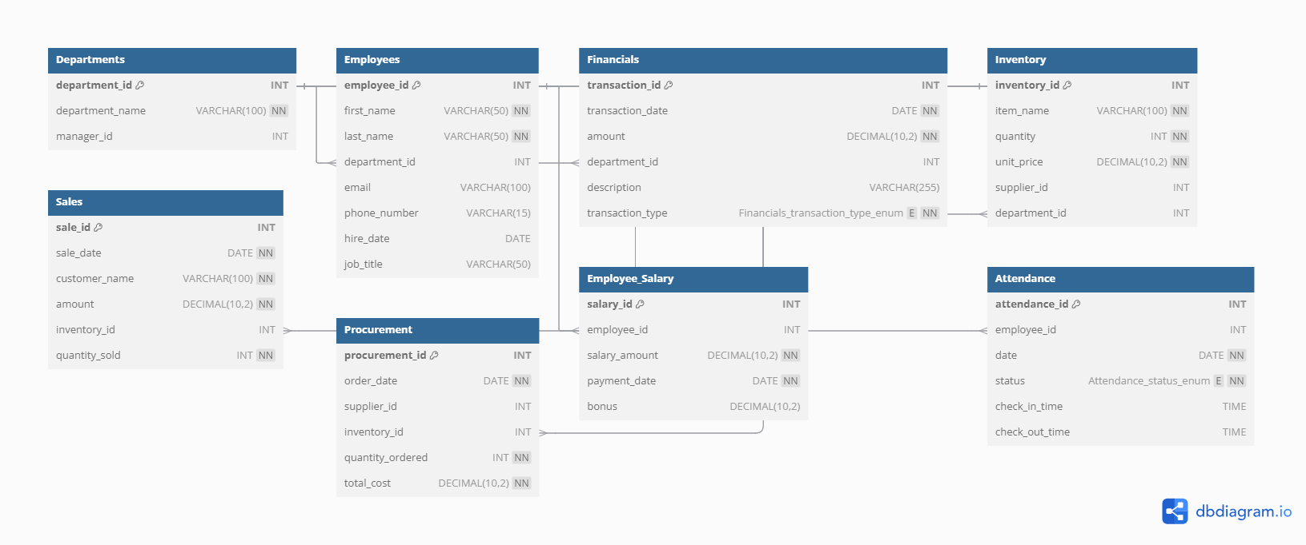
TABLES

Slide 6
STORE PROCEDURES
The following store procedures are created for the easy accessing of the queries
1.Get employees by department
2.Get total sales by item
3.Total salary paid
4.Get Financial Transactions by department
5.Get procurement orders by suppliers
6.Get sales by customer
7.Get salary details by employee
8.Get sales summary by item
9.Get departments by manager
10.Sales summary by item

Slide 7
Thank you

